Slide 1
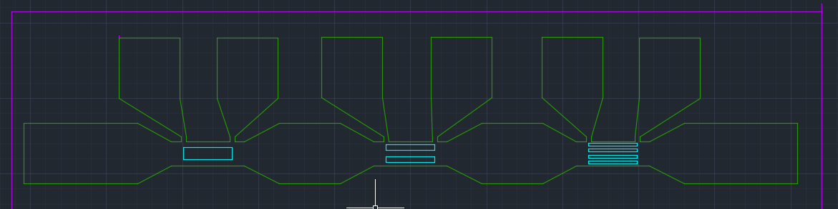
WO3196 IV-curve kinks
Measurements of Device 2 on WO3196
Light
Dark
25 C
65 C
In 0.1% H2/Ar at 1 bar
Settings
Max voltage set to 10V
0.2 s measurement time
4 point resistance measurement
V+
V-
I+
I-
Probe location are given in white
Inside green area is crystalline WO3, outside of it is amorphous WO3 on top of LAO
Inside cyan areas there is 5 nm of Pt

Slide 2
Terms
Light and dark: With and without a window in the chamber
‘Top’, ‘middle’, ‘bottom’ and ‘all’ for IV curve fits:
Top: Positive voltage part after kink
Middle: In between kinks
Bottom: Negative voltage before kink
All: Entire curve
‘Plus’ and ‘minus’ for IV curves
Plus: IV curve measured with increasing current
Minus: IV curve measured with decreasing current
Minus is measured directly after plus

Slide 3
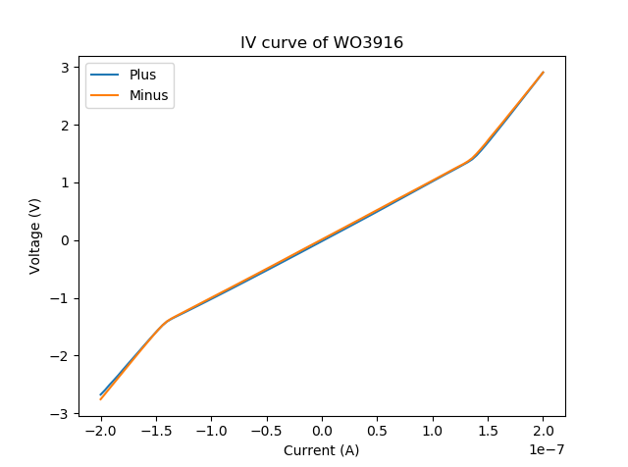
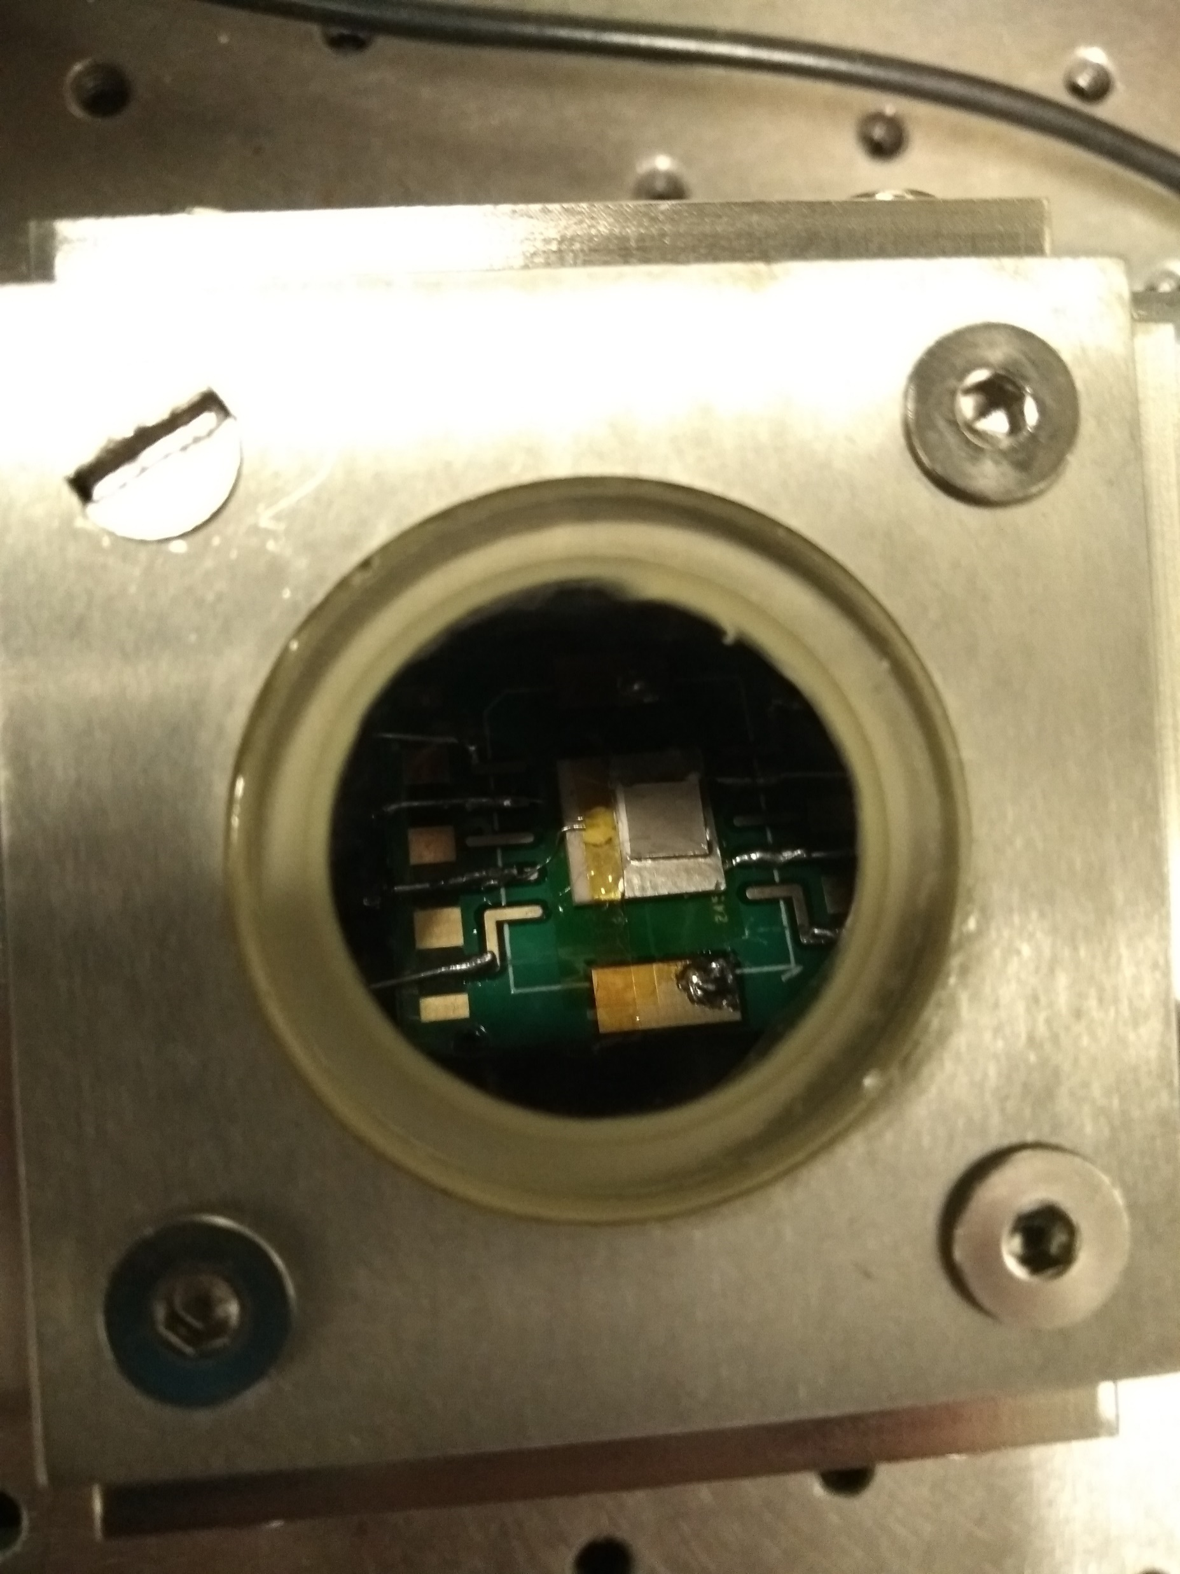
Light (with window)
Kinks at 1.5E-7 A and 1.5 V
Fit results
Name | Measurement | Direction | Position | R (Ohm) | R Std (Ohm)
0117_1703_WO3196_full_IV_curve | Light 25 | Minus | Bottom | 2.29E+07 | 1.48E+05
0117_1703_WO3196_full_IV_curve | Light 25 | Minus | Middle | 1.02E+07 | 5.69E+03
0117_1703_WO3196_full_IV_curve | Light 25 | Minus | Top | 2.35E+07 | 4.31E+04
0117_1703_WO3196_full_IV_curve | Light 25 | Plus | Bottom | 2.15E+07 | 1.09E+05
0117_1703_WO3196_full_IV_curve | Light 25 | Plus | Middle | 1.02E+07 | 1.99E+04
0117_1703_WO3196_full_IV_curve | Light 25 | Plus | Top | 2.39E+07 | 1.53E+05

Slide 4
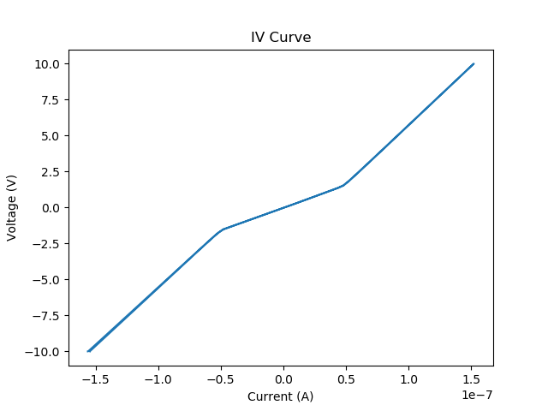
Dark 25 C
Also kinks at 1.5 V and 0.5e-7 A
Fit results
Name | Measurement | Direction | Position | R (Ohm) | R Std (Ohm)
0124_1816_WO3196_full_IV_curve_dark | Dark 25 | Minus | Bottom | 8.05E+07 | 2.78E+04
0124_1816_WO3196_full_IV_curve_dark | Dark 25 | Minus | Middle | 3.16E+07 | 8.11E+04
0124_1816_WO3196_full_IV_curve_dark | Dark 25 | Minus | Top | 8.19E+07 | 2.46E+04
0124_1816_WO3196_full_IV_curve_dark | Dark 25 | Plus | Bottom | 7.96E+07 | 3.31E+04
0124_1816_WO3196_full_IV_curve_dark | Dark 25 | Plus | Middle | 3.14E+07 | 7.42E+04
0124_1816_WO3196_full_IV_curve_dark | Dark 25 | Plus | Top | 8.21E+07 | 3.58E+04

Slide 5
Light and Dark comparison
Device has lower resistance in light

Slide 6
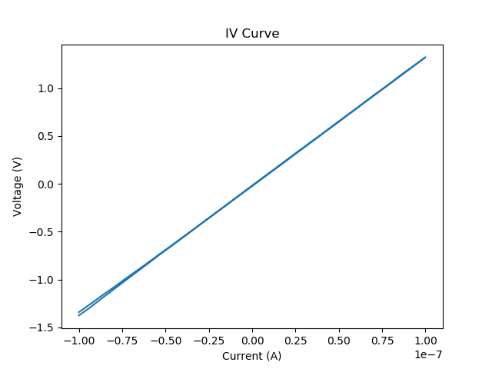
Dark 65 C (1)
No kinks at all
Did not reach 1.5V, so kink is not measured here
Fit results
Name | Measurement | Direction | Position | R (Ohm) | R Std (Ohm)
0127_1527_WO3196_full_IV_curve_dark | Dark 65 | Minus | All | 1.35E+07 | 8.73E+03
0127_1527_WO3196_full_IV_curve_dark | Dark 65 | Plus | All | 1.33E+07 | 1.47E+04

Slide 7
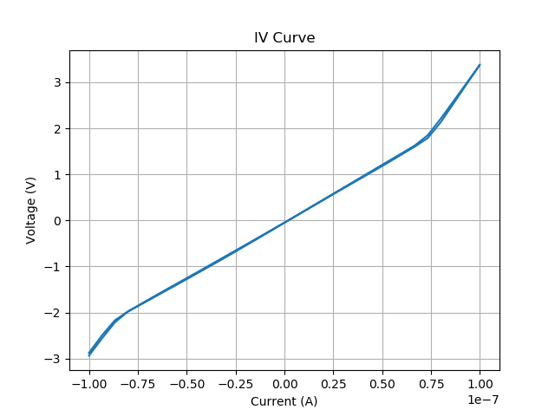
Dark 65C (2)
0220_1422_WO3196_iv_65C_4point
Here, source current is increased s.t. the voltage exceeds 1.5V
And the kinks show up again
Name | Measurement | Direction | Position | R (Ohm) | R Std (Ohm)
0220_1422_WO3196_iv_65C_4point | 4 point air | Minus | Top | 5.77E+07 | 5.37E+05
0220_1422_WO3196_iv_65C_4point | 4 point air | Minus | Middle | 2.48E+07 | 7.05E+04
0220_1422_WO3196_iv_65C_4point | 4 point air | Minus | Bottom | 5.43E+07 | 8.61E+05
0220_1422_WO3196_iv_65C_4point | 4 point air | Plus | Top | 6.02E+07 | 1.21E+06
0220_1422_WO3196_iv_65C_4point | 4 point air | Plus | Middle | 2.44E+07 | 4.84E+04
0220_1422_WO3196_iv_65C_4point | 4 point air | Plus | Bottom | 5.32E+07 | 2.18E+06

Slide 8
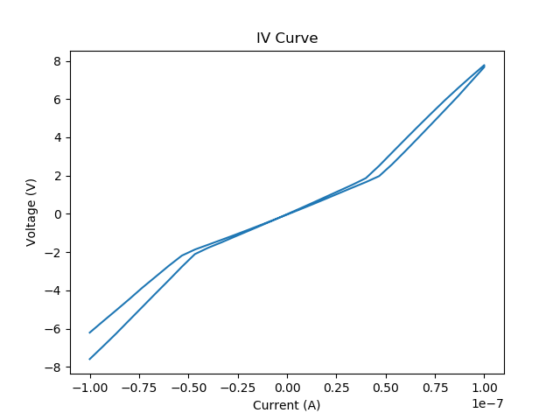
H2 Dark 25C
Kink also at 1.5 V
Resistance was changing over time, therefore the plus and minus curves are different
Fit results
Name | Measurement | Direction | Position | R (Ohm) | R Std (Ohm)
0127_1854_WO3196_full_IV_curve_h2_100nA | H2 25 | Minus | Bottom | 1.04E+08 | 4.19E+05
0127_1854_WO3196_full_IV_curve_h2_100nA | H2 25 | Minus | Middle | 4.55E+07 | 2.65E+05
0127_1854_WO3196_full_IV_curve_h2_100nA | H2 25 | Minus | Top | 9.95E+07 | 8.71E+05
0127_1854_WO3196_full_IV_curve_h2_100nA | H2 25 | Plus | Bottom | 8.67E+07 | 4.57E+05
0127_1854_WO3196_full_IV_curve_h2_100nA | H2 25 | Plus | Middle | 4.08E+07 | 2.89E+05
0127_1854_WO3196_full_IV_curve_h2_100nA | H2 25 | Plus | Top | 1.09E+08 | 7.52E+05

Slide 9
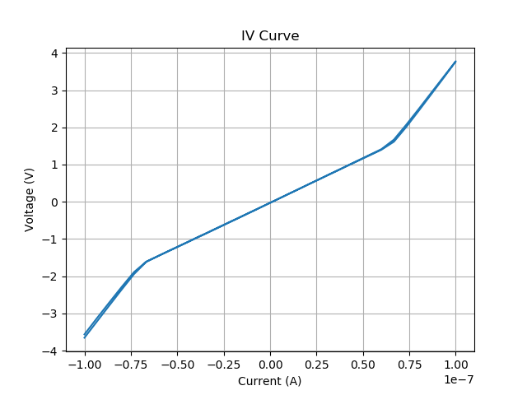
H2 Dark 65C
Kinks at 1.5V
Name | Measurement | Direction | Position | R (Ohm) | R Std (Ohm)
0220_1518_WO3196_iv_65C_h2_4point | 4 point h2 | Minus | Top | 6.35E+07 | 3.78E+05
0220_1518_WO3196_iv_65C_h2_4point | 4 point h2 | Minus | Middle | 2.39E+07 | 2.61E+04
0220_1518_WO3196_iv_65C_h2_4point | 4 point h2 | Minus | Bottom | 6.41E+07 | 2.72E+05
0220_1518_WO3196_iv_65C_h2_4point | 4 point h2 | Plus | Top | 6.50E+07 | 6.10E+05
0220_1518_WO3196_iv_65C_h2_4point | 4 point h2 | Plus | Middle | 2.37E+07 | 7.44E+03
0220_1518_WO3196_iv_65C_h2_4point | 4 point h2 | Plus | Bottom | 6.28E+07 | 4.91E+05

Slide 10
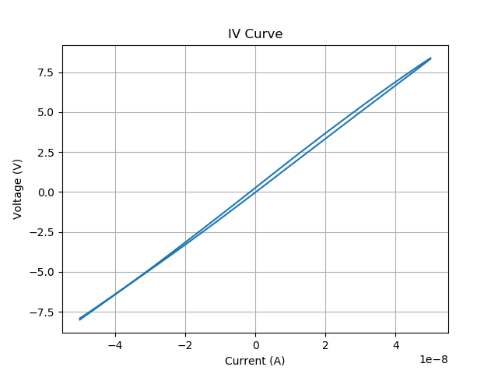
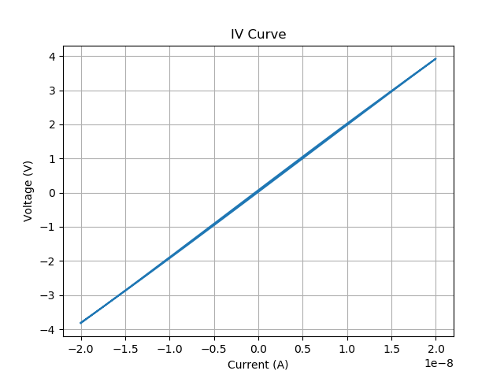
2-point IV Curve
H2
Air
0220_1449_WO3196_iv_65C_2point
Connected through voltage probes on device 2
No kinks in spectrum!
Does have higher resistance than 4-point measurement
Curiously higher when in hydrogen
Name | Measurement | Direction | Position | R (Ohm) | R Std (Ohm)
0220_1449_WO3196_iv_65C_2point | 2 point air | Plus | All | 1.64E+08 | 5.24E+05
0220_1449_WO3196_iv_65C_2point | 2 point air | Minus | All | 1.67E+08 | 4.49E+05
0220_1530_WO3196_iv_65C_h2_2point | 2 point h2 | Plus | All | 1.94E+08 | 2.22E+05
0220_1530_WO3196_iv_65C_h2_2point | 2 point h2 | Minus | All | 1.95E+08 | 1.89E+05

Slide 11
Contact resistance
0220_1422_WO3196_iv_65C_4point
0220_1449_WO3196_iv_65C_2point
0220_1518_WO3196_iv_65C_h2_4point
0220_1530_WO3196_iv_65C_h2_2point
H2
Air
Difference between contact resistance in H2 and in Air
Gas | 4point | 2point | Contact | Contact std
Air | 2.46E+07 | 1.65E+08 | 7.03E+07 | 5.24E+05
H2 | 2.38E+07 | 1.95E+08 | 8.53E+07 | 2.22E+05
Calculated as half the difference between the 2 and 4point measurements
Slightly higher in hydrogen
V+
V-
R contact
R contact
R device

Slide 12
Data (1)
Resistances IV curve light |  |  |  | Top = high voltage, bottom = negative voltage
Name | Measurement | Direction | Position | R (Ohm) | R Std (Ohm)
0117_1703_WO3196_full_IV_curve | Light 25 | Plus | Middle | 1.02E+07 | 1.99E+04
0117_1703_WO3196_full_IV_curve | Light 25 | Plus | Top | 2.39E+07 | 1.53E+05
0117_1703_WO3196_full_IV_curve | Light 25 | Plus | Bottom | 2.15E+07 | 1.09E+05
0117_1703_WO3196_full_IV_curve | Light 25 | Minus | Top | 2.35E+07 | 4.31E+04
0117_1703_WO3196_full_IV_curve | Light 25 | Minus | Bottom | 2.29E+07 | 1.48E+05
0117_1703_WO3196_full_IV_curve | Light 25 | Minus | Middle | 1.02E+07 | 5.69E+03
0124_1816_WO3196_full_IV_curve_dark | Dark 25 | Plus | Middle | 3.14E+07 | 7.42E+04
0124_1816_WO3196_full_IV_curve_dark | Dark 25 | Plus | Top | 8.21E+07 | 3.58E+04
0124_1816_WO3196_full_IV_curve_dark | Dark 25 | Plus | Bottom | 7.96E+07 | 3.31E+04
0124_1816_WO3196_full_IV_curve_dark | Dark 25 | Minus | Bottom | 8.05E+07 | 2.78E+04
0124_1816_WO3196_full_IV_curve_dark | Dark 25 | Minus | Middle | 3.16E+07 | 8.11E+04
0124_1816_WO3196_full_IV_curve_dark | Dark 25 | Minus | Top | 8.19E+07 | 2.46E+04
0127_1527_WO3196_full_IV_curve_dark | Dark 65 | Plus | All | 1.33E+07 | 1.47E+04
0127_1527_WO3196_full_IV_curve_dark | Dark 65 | Minus | All | 1.35E+07 | 8.73E+03
0127_1854_WO3196_full_IV_curve_h2_100nA | H2 25 | Plus | Bottom | 8.67E+07 | 4.57E+05
0127_1854_WO3196_full_IV_curve_h2_100nA | H2 25 | Plus | Middle | 4.08E+07 | 2.89E+05
0127_1854_WO3196_full_IV_curve_h2_100nA | H2 25 | Plus | Top | 1.09E+08 | 7.52E+05
0127_1854_WO3196_full_IV_curve_h2_100nA | H2 25 | Minus | Bottom | 1.04E+08 | 4.19E+05
0127_1854_WO3196_full_IV_curve_h2_100nA | H2 25 | Minus | Middle | 4.55E+07 | 2.65E+05
0127_1854_WO3196_full_IV_curve_h2_100nA | H2 25 | Minus | Top | 9.95E+07 | 8.71E+05

Slide 13
Data (2)
Only ‘middle’ and ‘all’ and only plus
Name | Measurement | Direction | Position | R (Ohm) | R Std (Ohm)
0117_1703_WO3196_full_IV_curve | Light 25 | Plus | Middle | 1.02E+07 | 1.99E+04
0124_1816_WO3196_full_IV_curve_dark | Dark 25 | Plus | Middle | 3.14E+07 | 7.42E+04
0127_1527_WO3196_full_IV_curve_dark | Dark 65 | Plus | All | 1.33E+07 | 1.47E+04
0127_1854_WO3196_full_IV_curve_h2_100nA | H2 25 | Plus | Middle | 4.08E+07 | 2.89E+05

Slide 14
Data (3)
2point and 4point measurements
Name | Measurement | Direction | Position | R (Ohm) | R Std (Ohm)
0220_1422_WO3196_iv_65C_4point | 4 point air | Minus | Top | 5.77E+07 | 5.37E+05
0220_1422_WO3196_iv_65C_4point | 4 point air | Minus | Middle | 2.48E+07 | 7.05E+04
0220_1422_WO3196_iv_65C_4point | 4 point air | Minus | Bottom | 5.43E+07 | 8.61E+05
0220_1422_WO3196_iv_65C_4point | 4 point air | Plus | Top | 6.02E+07 | 1.21E+06
0220_1422_WO3196_iv_65C_4point | 4 point air | Plus | Middle | 2.44E+07 | 4.84E+04
0220_1422_WO3196_iv_65C_4point | 4 point air | Plus | Bottom | 5.32E+07 | 2.18E+06
0220_1449_WO3196_iv_65C_2point | 2 point air | Plus | All | 1.64E+08 | 5.24E+05
0220_1449_WO3196_iv_65C_2point | 2 point air | Minus | All | 1.67E+08 | 4.49E+05
0220_1518_WO3196_iv_65C_h2_4point | 4 point h2 | Minus | Top | 6.35E+07 | 3.78E+05
0220_1518_WO3196_iv_65C_h2_4point | 4 point h2 | Minus | Middle | 2.39E+07 | 2.61E+04
0220_1518_WO3196_iv_65C_h2_4point | 4 point h2 | Minus | Bottom | 6.41E+07 | 2.72E+05
0220_1518_WO3196_iv_65C_h2_4point | 4 point h2 | Plus | Top | 6.50E+07 | 6.10E+05
0220_1518_WO3196_iv_65C_h2_4point | 4 point h2 | Plus | Middle | 2.37E+07 | 7.44E+03
0220_1518_WO3196_iv_65C_h2_4point | 4 point h2 | Plus | Bottom | 6.28E+07 | 4.91E+05
0220_1530_WO3196_iv_65C_h2_2point | 2 point h2 | Plus | All | 1.94E+08 | 2.22E+05
0220_1530_WO3196_iv_65C_h2_2point | 2 point h2 | Minus | All | 1.95E+08 | 1.89E+05
Difference between contact resistance in H2 and in Air
Gas | 4point | 2point | Contact | Contact std
Air | 2.46E+07 | 1.65E+08 | 7.03E+07 | 5.24E+05
H2 | 2.38E+07 | 1.95E+08 | 8.53E+07 | 2.22E+05

Slide 15
Source voltage limit
If the SMU has to apply too much voltage in order to get a certain source current, a limit may be hit causing the system to go into compliance state and thereby somehow increasing its resistance
This could be happening when the device voltage measured exceeds 1.5V and therefore be the cause of the kinks seen in the IV curves
Voltage cannot be measured by regular multimeter due to extremely high device resistance
Measured by 2-point resistance across current contacts
Slightly below 8V for 50 nA source current
Manual:
For source currents below 100 nA, the voltage limit is 210 V
So it looks like this is not the explanation for the IV curve kink

